Slide 1
CS F372 Operating Systems
14 – Deadlocks Avoidance

Slide 2
Text Book Reading
Chapter 7
Sections: 7.5.1, 7.5.3

Slide 3
Deadlock Avoidance
Requires that the system has some additional a priori information available
Simplest and most useful model requires that each process declare the maximum number of resources of each type that it may need
For any request, decide if the request can be satisfied immediately or it should wait
Resource-allocation state is defined by the number of available and allocated resources, and the maximum demands of the processes

Slide 4
Safe State
When a process requests a resource, system must decide if immediate allocation leaves the system in a safe state
A state is safe if the system can allocate resources to each process in some order and still avoid a deadlock
System is in safe state if there exists a safe sequence of all processes

Slide 5
Safe State
Sequence <P₁, P₂, …, P_{n}> is safe if for each P_{i}, the resources that Pi can still request can be satisfied by currently available resources + resources held by all the P_{j}, with j<i
If P_{i} resource needs are not immediately available, then P_{i} can wait until all P_{j} have finished.
When P_{j} is finished, P_{i} can obtain needed resources, execute, return allocated resources, and terminate.
When P_{i} terminates, P_{i+1} can obtain its needed resources, and so on.

Slide 6
Facts
If a system is in safe state ⇒ no deadlocks
If no safe sequence ⇒ system is unsafe state
Deadlocked state is an unsafe state
Not all unsafe states are deadlocks
If a system is in unsafe state ⇒ it may lead to deadlock
Avoidance ⇒ ensures that a system will never enter an unsafe state

Slide 7
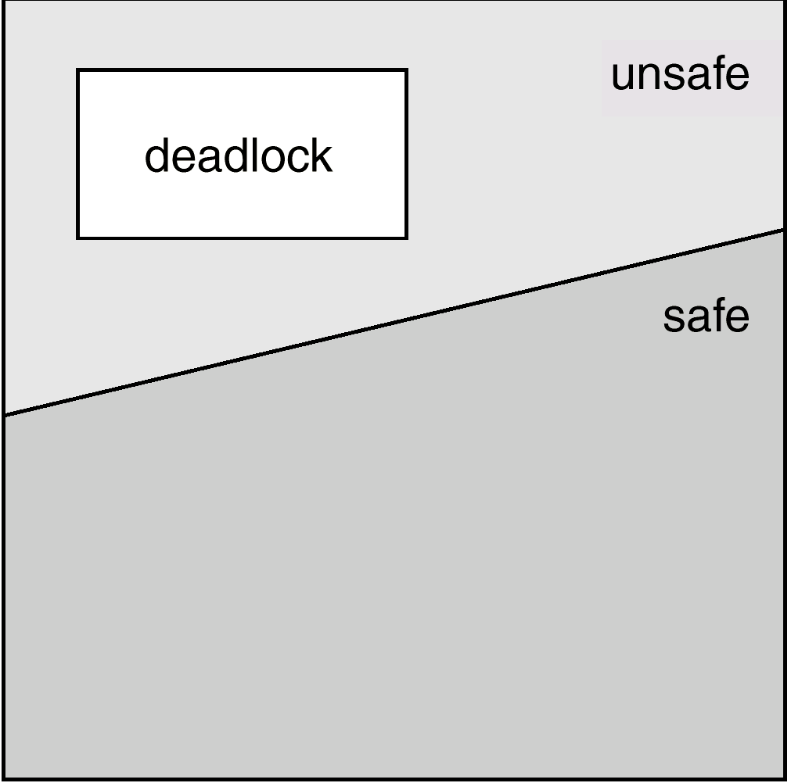
Safe, Unsafe, Deadlock State

Slide 8
Safe, unsafe states - Example
12 magnetic tape drives, 3 processes P0, P1, P2
Maximum Needs Current use Need
P0 10 5 5
P1 4 2 2
P2 9 2 7
Initially, system is safe, Safe sequence < P1, P0, P2>
A system may go from safe state to unsafe state
After the current allocation, if P2 requests and is allocated one more tape drive

Slide 9
Banker’s Algorithm
Banker’s algorithm can be used with multiple instances of each resource type
Each process must a priori declare its maximum use
This number must not exceed the total number of resources in the system
It has two parts: Safety algorithm and Resource request algorithm

Slide 10
Banker’s Algorithm
Safety algorithm: Given a resource allocation state, determines if the system is in a safe state or not
Resource request algorithm: Given a resource allocation state and the request for resources by a process, determines whether the request can be safely granted
Assumption: When a process gets all its resources it must return them in a finite amount of time.

Slide 11
Data Structures for the Banker’s Algorithm
n = number of processes
m = number of resource types
Available:
Vector of length m
If available [j] = k, there are k instances of resource type R_{j} available
A B C
3 3 2

Slide 12
Data Structures for the Banker’s Algorithm
Max:
n x m matrix
If Max [i,j] = k, then process P_{i} may request at most k instances of resource type R_{j}
A B C
P₀ 7 5 3
P₁ 3 2 2
P₂ 9 0 2
P₃ 2 2 2

Slide 13
Data Structures for the Banker’s Algorithm
Allocation:
n x m matrix
If Allocation[i,j] = k then P_{i} is currently allocated k instances of R_{j.}
A B C
P₀ 0 1 0
P₁ 2 0 0
P₂ 3 0 2
P₃ 2 1 1

Slide 14
Data Structures for the Banker’s Algorithm
Need:
n x m matrix
If Need[i,j] = k, then P_{i} may need k more instances of R_{j} to complete its task
Need [i,j] = Max[i,j] – Allocation [i,j]

Slide 15
Notations Used
If X and Y are vectors of length n
X ≤ Y iff X[i ] ≤ Y[i ] for all i = 1,2,…,n
Example
If X = (1,7,3,2), Y = (0,3,2,1)
Y ≤ X
Rows in the matrices Allocation and Need are treated as vectors and referred to as Allocationi and Needi respectively

Slide 16
Safety Algorithm
Let Work and Finish be vectors of length m and n, respectively.
Initialize:
Work = Available
Finish[i] = false for i = 1,2, …, n
2. Find an i such that both:
(a) Finish[i] = false
(b) Need_{i} ≤ Work
If no such i exists, go to step 4
3. Work = Work + Allocation_{i}
Finish[i] = true Go to step 2.
If Finish [i] == true
for all i, then the system
is in a safe state.

Slide 17
Example1 : Banker’s Safety Algorithm
5 processes P₀ through P₄; 3 resource types A (10 instances), B (5 instances), and C (7 instances)
Snapshot at time T₀:
Allocation Max Available
A B C A B C A B C
P₀ 0 1 0 7 5 3 3 3 2
P₁ 2 0 0 3 2 2
P₂ 3 0 2 9 0 2
P₃ 2 1 1 2 2 2
P₄ 0 0 2 4 3 3
Identify if the current resource allocation state is safe or unsafe.

Slide 18
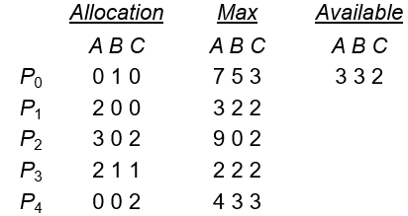
Example1 : Banker’s Safety Algorithm
The content of the matrix Need is defined to be Max – Allocation
Need
A B C
P₀ 7 4 3
P₁ 1 2 2
P₂ 6 0 0
P₃ 0 1 1
P₄ 4 3 1

Slide 19
Example1 : Banker’s Safety Algorithm
Allocation Need
A B C A B C
P₀ 0 1 0 7 4 3
P₁ 2 0 0 1 2 2
P₂ 3 0 2 6 0 0
P₃ 2 1 1 0 1 1
P₄ 0 0 2 4 3 1
Work = (3,3,2)
i = 0, Finish[0] = false
Is Need0 ≤ Work? (7 4 3) ≤ (3 3 2) = No

Slide 20
Example1 : Banker’s Safety Algorithm
Allocation Need
A B C A B C
P₀ 0 1 0 7 4 3
P₁ 2 0 0 1 2 2
P₂ 3 0 2 6 0 0
P₃ 2 1 1 0 1 1
P₄ 0 0 2 4 3 1
Work = (3,3,2)
i = 1, Finish[1] = false
Is Need1 ≤ Work? (1 2 2) ≤ (3,3,2) = Yes
Finish[1] = true, P₁ added to safe sequence < P₁>
Work = Work + Allocation₁ =(3,3,2) + (2,0,0) = (5,3,2)

Slide 21
Example1 : Banker’s Safety Algorithm
Allocation Need
A B C A B C
P₀ 0 1 0 7 4 3
P₁ 2 0 0 1 2 2
P₂ 3 0 2 6 0 0
P₃ 2 1 1 0 1 1
P₄ 0 0 2 4 3 1
Work = (5,3,2)
i = 2, Finish[2] = false
Is Need2 ≤ Work?
(6 0 0) ≤ (5,3,2) = No

Slide 22
Example1 : Banker’s Safety Algorithm
Allocation Need
A B C A B C
P₀ 0 1 0 7 4 3
P₁ 2 0 0 1 2 2
P₂ 3 0 2 6 0 0
P₃ 2 1 1 0 1 1
P₄ 0 0 2 4 3 1
Work = (5,3,2)
i = 3; Finish[3] = false
Is Need3 ≤ Work? (0 1 1) ≤ (5,3,2) = Yes
Finish[3] = true , P₃ added to safe sequence < P_{1,} P₃>
Work = Work + Allocation₃ =(5,3,2) + (2,1,1) = (7,4,3)

Slide 23
Example1 : Banker’s Safety Algorithm
Allocation Need
A B C A B C
P₀ 0 1 0 7 4 3
P₁ 2 0 0 1 2 2
P₂ 3 0 2 6 0 0
P₃ 2 1 1 0 1 1
P₄ 0 0 2 4 3 1
Work = (7,4,3)
i = 4; Finish[4] = false
Is Need4 ≤ Work? (4 3 1 ) ≤ (7,4,3) = Yes
Finish[4] = true, P₄ added to safe sequence < P₁ ,P₃, P₄ >
Work = Work + Allocation₄ =(7,4,3) + (0,0,2) = (7,4,5)

Slide 24
Example1 : Banker’s Safety Algorithm
Allocation Need
A B C A B C
P₀ 0 1 0 7 4 3
P₁ 2 0 0 1 2 2
P₂ 3 0 2 6 0 0
P₃ 2 1 1 0 1 1
P₄ 0 0 2 4 3 1
Work = (7,4,5)
i = 0; Finish[0] = false
Is Need0 ≤ Work? (7 4 3) ≤ (7,4,5) = Yes
Finish[0] = true , P₀ added to safe sequence < P₁ ,P₃, P₄ , P₀>
Work = Work + Allocation₀ =(7,4,5) + (0,1, 0) = (7,5,5)

Slide 25
Example1 : Banker’s Safety Algorithm
Allocation Need
A B C A B C
P₀ 0 1 0 7 4 3
P₁ 2 0 0 1 2 2
P₂ 3 0 2 6 0 0
P₃ 2 1 1 0 1 1
P₄ 0 0 2 4 3 1
Work = (7,5,5)
i = 2, Finish[2] = false
Is Need2 ≤ Work? (6 0 0) ≤ (7,5,5) = Yes
Finish[2] = true , P₂ added to safe sequence < P₁ ,P₃, P₄ , P₀ , P₂ >
Work = Work + Allocation₂ =(7,5,5) + (3,0,2) = (10,5,7)

Slide 26
Example1 : Banker’s Safety Algorithm
The system is in a safe state since the sequence < P₁, P₃, P₄, P₂, P₀> satisfies safety requirement

Slide 27
Resource-Request Algorithm for Process P_{i}
Request_{i}
Request vector for process P_{i}
If Request_{i} [j] = k then process P_{i} wants k instances of resource type R_{j.}
If Request_{i} ≤ Need_{i} go to step 2. Otherwise, raise error condition, since process has exceeded its maximum claim.
If Request_{i} ≤ Available, go to step 3. Otherwise P_{i} must wait, since resources are not available.

Slide 28
Resource-Request Algorithm for Process P_{i}
3. Pretend to allocate requested resources to P_{i} by modifying the state as follows:
Available = Available - Request_{i}
Allocation_{i} = Allocation_{i} + Request_{i}
Need_{i} = Need_{i} – Request_{i}
4. Run the safety algorithm to check if the system is in a safe state
If safe ⇒ the resources are allocated to P_{i}
If unsafe ⇒ P_{i} must wait, and the old resource-allocation state is restored

Slide 29

Example 2: Banker’s Resource Request Algorithm P₁ Request (1,0,2)
For the resource allocation state given below, examine if P₁’s Request (1,0,2) can be granted
1. Check Request1 ≤ Need1 (that is, (1,0,2) ≤ (1,2,2) ⇒ true.
2. Check Request1 ≤ Available (that is, (1,0,2) ≤ (3,3,2) ⇒ true.

Slide 30
Example 2: Banker’s Resource Request Algorithm P₁ Request (1,0,2)
3. Pretend to allocate requested resources to P_{i} by modifying the state as follows:
Available = Available – Request₁ ⇒(3,3,2) – (1,0,2) = (2, 3,0)
Allocation₁ = Allocation₁ + Request₁ ⇒(2,0,0) + (1, 0, 2) = (3, 0, 2)
Need₁ = Need₁ – Request₁ ⇒ (1, 2, 2) - (1, 0, 2) = (0, 2, 0)
Allocation Need Available
A B C A B C A B C
P₀ 0 1 0 7 4 3 2 3 0
P₁ 3 0 2 0 2 0
P₂ 3 0 2 6 0 0
P₃ 2 1 1 0 1 1
P₄ 0 0 2 4 3 1

Slide 31
Example 2: Banker’s Resource Request Algorithm P₁ Request (1,0,2)
4. Executing safety algorithm shows that sequence <P₁, P₃, P₄, P₀, P₂> satisfies safety requirement
Request of P₁ can be granted.

Slide 32
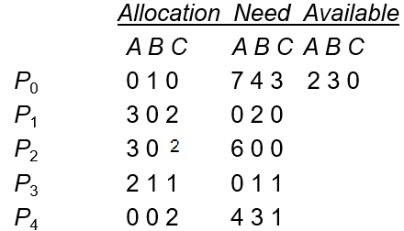
Example 3: Banker’s Resource Request Algorithm P₄ request (3,3,0)
Assume the current resource allocation state given below. Can request for (3,3,0) by P₄ be granted?

Slide 33
Example 3: Banker’s Resource Request Algorithm P₄ request (3,3,0)
Check if Request4 ≤ Need4
that is, (3,3,0) ≤ (4,3,1) ⇒ true.
2. Check if Request4 ≤ Available
that is, (3,3,0) ≤ (2,3,0) ⇒ false.
No. Request of P4 cannot be granted as resources are not available. P4 should wait.

Slide 34
Example 4: Banker’s Resource Request Algorithm P₀ Request (0,2,0)
Assume the current resource allocation state given below. Can request for (0,2,0) by P₀ be granted?

Slide 35
Example 4: Banker’s Resource Request Algorithm P₀ Request (0,2,0)
1. Check Request₀ ≤ Need₀ = (0,2,0) ≤ (7,4,3) ⇒ true.
2. Check Request₀ ≤ Available; (0,2,0) ≤ (2,3,0) ⇒ true.
3. Pretend to allocate requested resources to P_{i} by modifying the state as follows:
Available = Available – Request₀ (2, 3, 0) – ( 0, 2, 0) = (2, 1, 0)
Allocation₀ = Allocation₀ + Request₀ (0, 1, 0) + ( 0, 2, 0) = ( 0, 3, 0)
Need₀ = Need₀ – Request₀ (7, 4, 3) – (0, 2, 0) = (7, 2, 3)

Slide 36
Example 4: Banker’s Resource Request Algorithm P₀ Request (0,2,0)
Allocation Need Available
A B C A B C A B C
P₀ 0 3 0 7 2 3 2 1 0
P₁ 3 0 2 0 2 0
P₂ 3 0 2 6 0 0
P₃ 2 1 1 0 1 1
P₄ 0 0 2 4 3 1
No safe sequence.
Request of P₀ is not granted.
P₀ has to wait.

